Slide 1
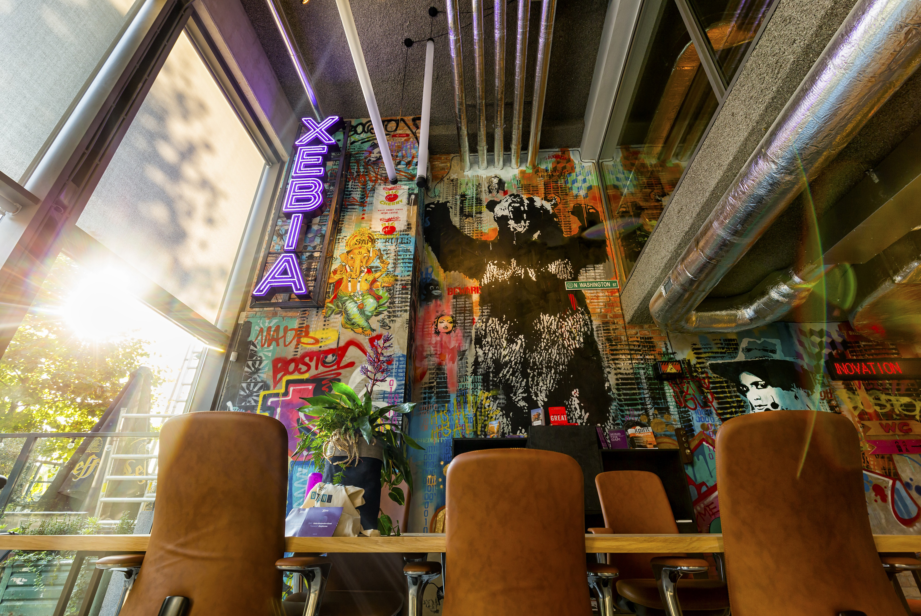
Xebia – Company Overview
With over 20 years of experience, our global network of passionate technologists and pioneering craftsmen deliver cutting-edge technology and game-changing consulting to companies on the brink of transformation.
Founded in 2001, Xebia was the first Dutch organization to embrace the Agile way of working, with gurus like Jeff Sutherland. Since then, we have grown from a Java company into a full-service digital consulting company with 6,500 professionals working on a worldwide ambition.
We are organized in complementary chapters – teams with a tremendous amount of knowledge and experience within a particular field, such as Agile, DevOps, Data and AI, Cloud, Software Technology, Security, Low Code, and Microsoft Services.
We help the world’s top 250 companies and category leaders overcome digital challenges, embrace innovation, adopt new technology, and implement new business models. In addition to high-quality consulting, we also provide offshoring and nearshoring services.
The Xebia Group was founded by Daan Teunissen, Founder & CEO. Please see the detailed Key Leaders list.
Notes:
Guido

Slide 2

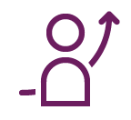



Introduction to Xebia
Xebia Values
People First
Xebia puts people first. We actively enable continuous personal and professional growth. With respect, trust, responsibility, and accountability. We cultivate great ideas, innovate and actively support you to become your very best. That’s how we have grown.
Xebia is a pioneering IT consultancy company founded in the Netherlands in 2001, following 1 mission, 4 values and 4 business principles.
We consist of specialized, interlinked companies that closely cooperate to serve our customers on a worldwide scale. We offer our clients full-stack digital transformation services and solutions.
Sharing Knowledge
Supporting the passion of exceptionally smart people forms the foundation of our organization. Our bi-weekly company-wide knowledge exchanges, innovation days, tech-rallies and training programs make knowledge flow within Xebia and beyond and contribute to exploring and achieving our full potential, individually and collectively.
Our Mission: ‘Authority’
Quality without Compromise
This mission was defined in 2004 and has guided Xebia ever since to become the company it is today: 6500+ people with over 24+ offices globally.
Our mission can be translated into 4 tangible drivers:
Become the no. 1 or 2 in each of our market domains
Always perform the 9 on a scale of 10
Authority is our Big Hairy Audacious Goal
Be the best professional in a specific domain area.
When teaming up with Xebia, expect in-depth expertise based on an authentic, values-led and high-quality driven way of working that inspires all we do. We sometimes call ourselves “Mainstream Frontrunners’’. And it all starts with hiring the right people.
At Xebia, quality without compromise is the mantra. Be it the work we do for our customers, the tools we all work with, our hiring process, our parties or our offices' design. We set the bar at 100%, because we don’t compromise.
Customer Intimacy
We build long-lasting relationships with our customers and serve them on an equal level. We work on common goals and trust by showing genuine interest in the person and adding value pro-actively and consistently.
Notes:
Guido

Slide 3
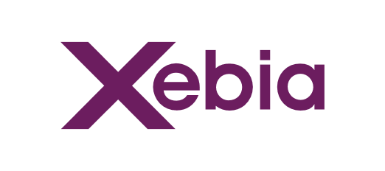
Mission
Values
Business Principles
Facts
Authority
People First
Sharing Knowledge
Quality Without Compromise
Customer Intimacy
Responsibility
Entrepreneurship and Innovation
Sense of Urgency
Results
Founded: 2001
People: 6500+
Revenue: 400M USD (FY22)
Regions: Americas, Continental Europe, UK, MEA & APAC (India, South-east Asia, ANZ)
Purpose
We create digital leaders and build resilient organizations at any scale. Our passion for people, technology and sharing knowledge makes us uniquely qualified to do so.
Service Lines
Transformation
Data
Cloud
Software Technology
Low Code
Microsoft Solutions
Program Management
Strategy and Data Transformation
Strategy and Cloud Migration
Software Architecture
and Design
Low Code Platform Consulting
Azure Cloud Transformations
Agile Transformation
and Consulting
Analytics Translation and
Business intelligence
Cloud Native Infrastructures
Software Development (incl. Functional)
Low Code Architecture and Development
Cloud Native Software Development
Product Management, Architecture and Design
Data Science and AI
Cloud Health and Cost Optimizations
ISV product Co-Design and Engineering
Low Code Accelerators and Solutions
(Cloud) Application Modernization
DevOps and SRE
Data engineering, platforms, and architecture
Standard Components
Quality Assurance, Testing and Security
Appian, OutSystems, Salesforce and Mendix
Managed Services
Data Standard Components and Solutions
Cloud Based Workplace Components
Managed Services
Managed Services
Alliances (Technology and Industry)
Standard Solutions
Academy
Notes:
Guido

